Slide 1
Chapter 6 Queue Management
Speaker: H.M. Liang

Slide 2
Background
Queue management
  FIFO queue
    TCP Global Synchronization
  Random Early Detection (RED)
    Congestion avoidance

Slide 3
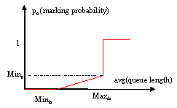
RED algorithm
If avg < min_{th}
  No drop
If Min_{th}< avg < max_{th}
  Randomly drop the packets
If avg > Max_{th}
  Drop all the packets
Notes:
Predefined variables minth, maxth Minp.
Minp should not be too large. If it is too large, it will cause the oscillation of the average queue size.
Why using average queue size instead of the actual queue size?

Slide 4

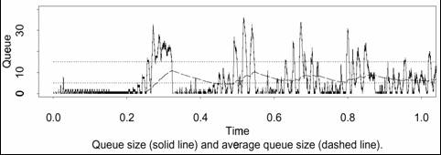
Average Queue Size
Low-pass filter:
Example:
Notes:
Why we use average queue size instead of actual queue size in RED: 1. Allow transient congestion 2. Don’t want control input fluctuate dramatically.
(1) If idle, avg = (1-w_{q})^{m} avg
(2) 0<w_{q}<1, consider if w_{q}=1, the filter is not low pass filter.
(3) So w_{q} cannot be too large to make it filter out the transient congestions, so that the gateway can accommodate transient congestions. Also if w_{q} is too large, the value of avg may fluctuate significantly, which is not good to provide the feedback.
(4) W_{q} cannot be too small. If it is too small, avg responds too slow to the changes in actual queue size.
The lower bound of the w_{q} is determined by the “Time Constant” of the filter.

Slide 5
Decide min_{th} and max_{th}
Set min_{th} sufficient high to maximize network powder.
Make max_{th} - min_{th} sufficient large to avoid global synchronization. It should be larger than the increase of queue size in one RTT.
Notes:
Min_{th} depends on the magnitude of the transient congestions being allowed by the gateway.
The amount of bursts that can be accepted by the gateway.
Network powder = (throughput)/(average delay)
Max_{th} depends on the maximum average delay of the network.

Slide 6

Calculate the marking probability
Geometric random variables:
  Use P_{b} to drop the packets
Uniform random variables:
  Use P_{a} instead of P_{b} to drop the packets
where count is # of packets since last droping
Notes:
In the geometric random variable case, the packet right after the marked packet has bigger chance to be marked than packets far away from the marked packet.
Consider the busty traffic, it is more likely for the gateway to receive server continuous packets from the same connection.
If we use the geometric random variables to mark, there will produce the bias against bursty traffic.
In the uniform random variable case, when n<1/p_{b}, the Prob[X=n] = p_{b}. When n>1/p_{b}, Prob[X=n] = 0.

Slide 7
TCL
$ns duplex-link $r1 $r2 56k 10ms RED
$ns queue-limit $r1 $2 50
set q_ [[$ns link $r1 $r2 ] queue]
$q_ trace curq_

Slide 8
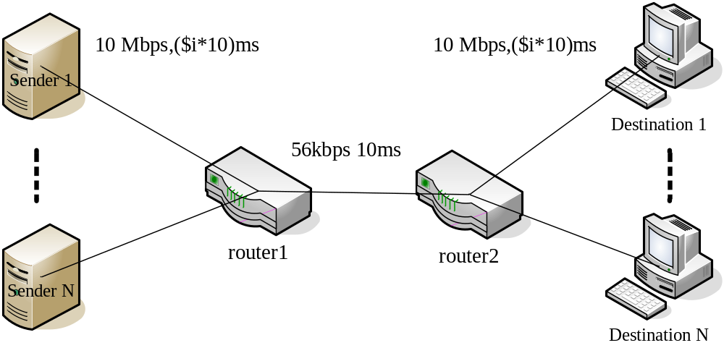
Experiment topology

